Slide 1
Postsecondary and Workforce Readiness Act: Key Provisions and Opportunities
Jonathan Furr
Education Systems Center at NIU
November 3, 2016

Slide 2
PWR Act
Public Act 99-0674 (HB 5729); signed by Governor on 7/29/16
Four components:
Postsecondary and Career Expectations (PaCE)
Pilot of Competency-based High School Graduation Requirements
Scaling of 12th Grade Transitional Courses
College & Career Pathway Endorsements on High School Diplomas
Notes:
For past three years, P-20 Council’s College & Career Readiness Committee has led a process to define policies to improve student transitions from high school to postsecondary education and careers. This process has included extensive stakeholder engagement, consultation with state agency leadership, and a hearing before the House Higher Education committee.
In May 2015, House Resolution 477 was adopted to establish advisory committees to issue recommendations in four areas where there was a need and stakeholder consensus to move forward. Each of these committees met three times from October 2015 through January 2016, involving over 120 members representing school districts, community colleges, universities, employers, state agencies, advocacy organizations, and other stakeholders. Led to the adoption of a set of recommendations, available on the website link. Now incorporated into HB 5729 filed by Representative Burke. I’m going to quickly walk through these, but it’s important to understand the relationship across these four areas – all are seeking to establish more seamless high school and postsecondary systems that orient a student’s education around her individualized career goals, and are more focused on outcomes – what students know – rather than inputs such as seat time and instructional methods.

Slide 3
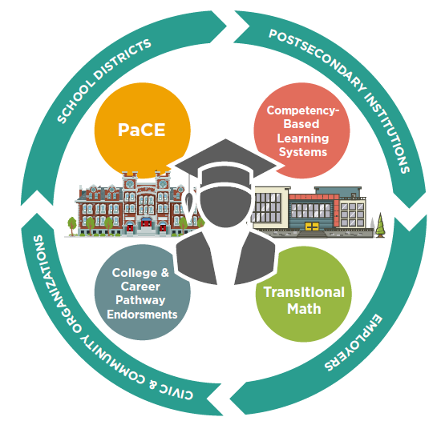

Slide 4
PWR Act Background
P-20 Council PWR Steering Committee
- Met from 5/2012 to 7/2013
HB 3196
- Filed 2/15
HR 477
- Identified 5 aspects of PWR policy agenda where there was greater consensus for moving forward
- Adopted by House on 5/30/15
- 4 advisory committees with over 120 stakeholders each met 3 times; delivered recommendations on 2/1/16
- Developed college & career readiness framework and key success factors
- Resulted from over one year of meetings with agency leadership in context of PWR key success factors
- Joint committee of College & Career Readiness and Data, Assessment, and Accountability
PWR Act
Notes:
For past three years, P-20 Council’s College & Career Readiness Committee has led a process to define policies to improve student transitions from high school to postsecondary education and careers. This process has included extensive stakeholder engagement, consultation with state agency leadership, and a hearing before the House Higher Education committee.
In May 2015, House Resolution 477 was adopted to establish advisory committees to issue recommendations in four areas where there was a need and stakeholder consensus to move forward. Each of these committees met three times from October 2015 through January 2016, involving over 120 members representing school districts, community colleges, universities, employers, state agencies, advocacy organizations, and other stakeholders. Led to the adoption of a set of recommendations, available on the website link. Now incorporated into HB 5729 filed by Representative Burke. I’m going to quickly walk through these, but it’s important to understand the relationship across these four areas – all are seeking to establish more seamless high school and postsecondary systems that orient a student’s education around her individualized career goals, and are more focused on outcomes – what students know – rather than inputs such as seat time and instructional methods.

Slide 6
Model Postsecondary and Career Expectations
By end of 12th grade
ISBE, ICCB, IBHE, ISAC
7/1/2017
By end of 11th grade
By end of 10th grade
By end of 9th grade
Activities to complete
Related knowledge students should possess
Supported by school districts, parents, community
By end of 8th grade
Career Exploration and Development
College Exploration, Preparation, and Selection
Financial Aid and Literacy

Slide 7
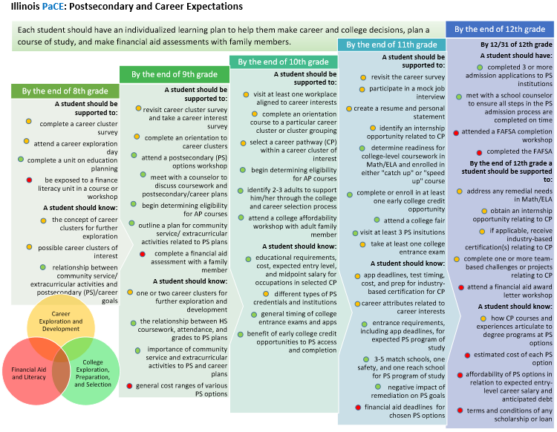
Notes:
The PaCE (Postsecondary and Career Expectations) framework provides guidance to parents, teachers, school administrators, community-based organizations, and students on what experiences students should have and what information students should know during their progression from middle grades through high school. The framework is organized around three key areas for student success (Career Exploration and Development; College Exploration, Preparation, and Selection; and Financial Aid and Literacy) and the principle that practical and financial preparation for college and career can and should be done together.
Coordinating framework for all school districts, community partners, and families to understand that they need to support students to “keep PaCE” and build out the systems that make that happen.

Slide 8
Opportunities for Leading Communities

Slide 10
Why?
Recognize and incentivize student attainment of knowledge and demonstrations of skills important for both success in both postsecondary and employment
Encourage career exploration and development to improve decision-making
Promote greater consistency of college and career pathway program structures
Institutionalize college and career pathways as a key strategy for postsecondary and career success

Slide 12
Implementation Timeline
Agencies develop plan, define framework, establish public-private committees
Steering committees recommend competencies
School districts submit info to agencies to offer endorsement programs
First high school graduates with endorsements
19-20 SY
18-19 SY
17-18 SY
16-17 SY

Slide 14
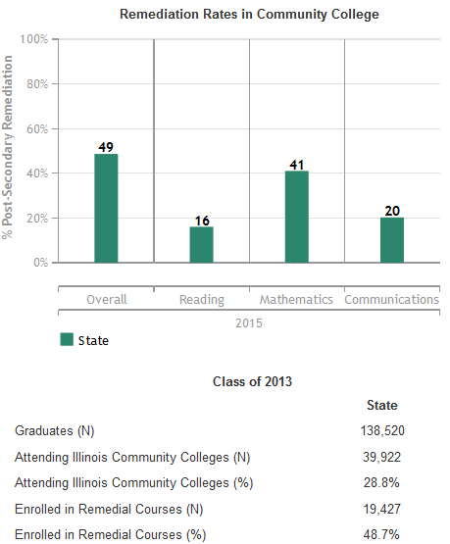
Why?
Notes:
Transitional math courses are courses delivered to students during the senior year of high school which, if successfully completed as determined based on an overall course grade, result in transcripted credit that can guarantee student placement into either an IAI transfer-level math course or a credit-bearing math course required for career and technical postsecondary education programs.
Transitional math courses are typically delivered by high school faculty with community college collaboration defined through a local partnership agreement. While transitional math competencies may be delivered through a stand-alone course, integrated models are encouraged.

Slide 15
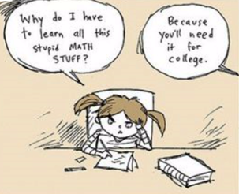
Why?
Notes:
Transitional math courses are courses delivered to students during the senior year of high school which, if successfully completed as determined based on an overall course grade, result in transcripted credit that can guarantee student placement into either an IAI transfer-level math course or a credit-bearing math course required for career and technical postsecondary education programs.
Transitional math courses are typically delivered by high school faculty with community college collaboration defined through a local partnership agreement. While transitional math competencies may be delivered through a stand-alone course, integrated models are encouraged.

Slide 16
Postsecondary Math Pathways
STEM
Career goals that require application of calculus or advanced algebraic skills
Technical
Career goals in technical fields that do not require application of calc, advanced algebraic, or advanced stats skills
Quantitative Literacy/ Stats
Career goals outside of STEM or Technical – focus on general stats, data analysis, quant. literacy, problem solving

Slide 17
Transitional Math: A Student’s Perspective
11th Grade Projected Readiness Determination:
Use statewide criteria
Based on each student’s postsecondary math pathway
Not Projected Ready:
Transitional math co-developed by school district and community college
Projected Ready:
Student decides whether to take math in 12th grade
Successful Completion of Transitional Math:
Placed in college-level math course in applicable math pathway
Unsuccessful Completion or No Math Senior Year:
Subject to general placement processes
Successful Completion of Rigorous Math in 12th Grade:
Placed in college-level math course in applicable math pathway

Slide 18
Opportunities for Leading Communities
Statewide Panel is convened and initially considers competencies & requirements
Final panel recommendations; ISBE/ICCB adopt transitional math criteria
ISBE/ICCB adopt phased implementation plan
Any school district may implement
* Leading high school/community college partnerships inform panel’s and agencies’ work
19-20 SY
18-19 SY
17-18 SY
16-17 SY

Slide 20
Flexibility for Local Innovation
A participating school district can decide:
Which years?
Which graduation requirements?
Which high schools?
Core strategy supporting the community’s efforts to better prepare students for college, career, and life
Notes:
5 core common criteria:
Students must demonstrate mastery of all required competencies to earn credit.
Students advance once they have demonstrated mastery, and students receive more time and personalized instruction to demonstrate mastery if needed.
Students have the ability to attain advanced college and career-related competencies beyond those needed for graduation. There is no “ceiling” for competency attainment while in high school.
Students are assessed using multiple measures to determine mastery, usually requiring application of knowledge.
Students can earn credit toward graduation in ways other than seat time, including learning opportunities outside the traditional classroom setting.
Districts replacing core academic graduation requirements (language arts, math, or science) with a competency-based system must demonstrate how competencies can be demonstrated in Career and Technical Education (CTE) courses and professional learning experiences. Integrated courses including equal focus on academic and CTE components are encouraged.
All plans must incorporate “adaptive competencies” defined by the school district. Adaptive competencies are foundational skills needed for success in college, careers, and life such as, but not limited to, work ethic, professionalism, communication, collaboration and interpersonal skills, and problem-solving.
Postsecondary partners: No “ceiling” for competency attainment; ensure student outcomes can be translated for admission and financial aid.

Slide 21
Waivers
Participating school districts can obtain State Supt. waiver or modification of any School Code provisions/rules to support the proposed competency-based system
However, no waivers for: State assessments, accountability, teacher tenure/seniority, evaluations, or protections for particular groups of students (SWD, ELL)
Any waiver of teacher educator licensure requirements must ensure that an appropriately licensed teacher and the provider of instruction jointly determine the method for assessing competency of mastery and jointly verify whether a student has demonstrated mastery
Notes:
5 core common criteria:
Students must demonstrate mastery of all required competencies to earn credit.
Students advance once they have demonstrated mastery, and students receive more time and personalized instruction to demonstrate mastery if needed.
Students have the ability to attain advanced college and career-related competencies beyond those needed for graduation. There is no “ceiling” for competency attainment while in high school.
Students are assessed using multiple measures to determine mastery, usually requiring application of knowledge.
Students can earn credit toward graduation in ways other than seat time, including learning opportunities outside the traditional classroom setting.
Districts replacing core academic graduation requirements (language arts, math, or science) with a competency-based system must demonstrate how competencies can be demonstrated in Career and Technical Education (CTE) courses and professional learning experiences. Integrated courses including equal focus on academic and CTE components are encouraged.
All plans must incorporate “adaptive competencies” defined by the school district. Adaptive competencies are foundational skills needed for success in college, careers, and life such as, but not limited to, work ethic, professionalism, communication, collaboration and interpersonal skills, and problem-solving.
Postsecondary partners: No “ceiling” for competency attainment; ensure student outcomes can be translated for admission and financial aid.

Slide 22
Implementation Timeline
State Supt publishes initial application
School districts selected for initial pilot; commence planning
School districts submit full plan, commence implementation
State Supt can establish a new cohort
19-20 SY
18-19 SY
17-18 SY
16-17 SY

Slide 23
Jon Furr
jfurr@niu.edu

